Slide 1



Proposal to Assist Fremont and Kimco Validate and Further Develop the rocketstop.com Concept
August 17, 1999

Slide 2
Contents
Key Issues
Our Understanding
  Kimco / Fremont
  Rocketstop.com Concept
  State of Internet Retailing
  Key Trends in On-line Retailing
Objectives and Approach
PwC Qualifications

Slide 3
Key Issues / Why We’re Here
Kimco’s tenants will be affected by consumer purchases moving to the web through the exponential growth of e-commerce initiatives.
Kimco’s interest is to retain tenants and assist them in leveling the playing field with web based purchases which include delivery as a feature.
Individual retailers may not be able to support the infrastructure requirements necessary to create and maintain websites or to provide local delivery services.
Local delivery is a growing trend and Fremont/Kimco see an opportunity to be first-to-market with a national offering.
The concept is to provide a community oriented website for each of the strip center locations which includes special services for the tenants.
PwC has been asked to assist the joint venture of Fremont Realty Group and Kimco Realty, conduct strategy sessions, and develop a successful business model and plan which can meet these local market needs.

Slide 4


Fremont / Kimco at a Glance
General
  Publicly traded Real Estate Investment Trust
  Acquires, develops and manages shopping centers
  Interest in 458 Properties in 40 States
  Concentration in Florida, Illinois, Ohio and Penn.
  59 million square feet of leasable space
  Manages an add’l 31 properties and 4.1 million sq. ft.
General
  Private Investment Company
  Five lines of business
  Nearly $10 billion in assets under management
  Bechtel family owns majority interest
Business Lines
  Direct Investments-private equity investments
  Venture Capital - early-stage funding
  Real Estate - invests in public and private real estate
  Infrastructure - seeks infrastructure and energy oppy’s
  Securities Management - offers a family mutual funds
Competitors
  General Growth properties
  Simon Property Group
  Urban Shopping Centers
1998 Highlights
  Broke ground on San Francisco office building
  Completed three successful initial public offerings
  Closed new Trinity VI fund at 140 million
  Acquired majority equity position in Leggat McCall
Key Statistics
1998 1997
  Net sales (mil) 353.6 213.1
  % Increase 65.9% 17.4%
  Net Income 122.3 85.8
  Employees 199 168

Slide 5
The rocketstop.com concept is positioned to be a community-focused portal, providing information, shopping, and delivery services
Rocketstop.com will:
Provide a portal service / community-oriented website which includes local news, information, functionality, etc.
Provide e-commerce capabilities for Kimco tenants. Ideas include:
  Portal capabilities for customers to gain access to inventory (stock status) and pricing information
  Hot-link capabilities both to and from tenants with existing web capabilities
Provide local delivery services. Ideas include:
  Deliveries for tenants
  Deliveries for other local businesses not in direct competition with tenants

Slide 6
Our vision: Five phases of E-business evolution in retail
Restructuring the value chain to create “many-to-many” relationships, new value propositions & new business models
4 - Industry
Transformation
New industry sectors entering the business of retailing and retailers entering new industry sectors
3 - Convergence
Future
Phases
2 - Value Chain
Integration
Connections with trading partners & process changes across the value chain (buy side)
Current
Phases
Degree of change to business model
1 - Channel Enhancement
Enhancing current channels and adding new channels to market (sell side)
0 - Intra-Enterprise Connectivity
Internet technology enabled process, systems & organisational change & getting the organisation connected
Role of E-Business
Notes:
Our landscape for e-business evolution:
E-business initially enables selling and buying activities, with firms doing the same type of activities more efficiently (box one and two)
Second stage is equivalent of the railway and telegraph revolution: complete restructuring of value chains, creation of new virtual firms and cybersourcers (box three)
Finally, process specialists take their expertise to new markets - a virtual version of the convergence on attractive markets familiar from the physical world

Slide 7
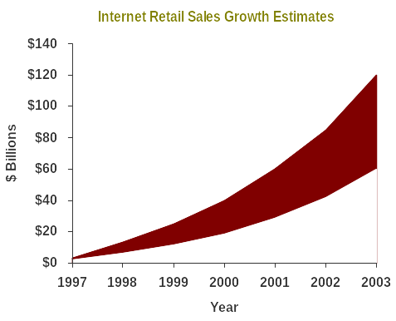
On-line retail sales are estimated to grow from $18 - $25B in 1999 to $100B+ by 2003; projected 1999 on-line sales show new categories beginning to make an impact
1999 Projected On-line Sales and Penetration Rates
PC Hardware / Software
$7,400
9.2%
Collectibles
$5,400
N/A
Music / Video
$1,700
1.8%
Books
$1,500
5.1%
Flowers / Cards / Gifts
$1,400
N/A
Apparel / Accy’s
$1,400
0.3%
Department Stores
$1,300
0.3%
Event Tickets
$1,200
5.0%
Consumer Electronics
$770
2.3%
Automotive
$460
N/A
Home / Garden
$440
0.1%
Toys
$270
0.5%
Food / Wine
$230
<0.1%
$0
$2,000
$4,000
$6,000
$8,000
$ Millions
Sources: Jupiter Communications, Morgan Stanley, Yankee Group, IDC, Forrester Research, shop.org, and PwC.

Slide 8
Goldman Sachs, however, suggests only moderate E-Retail (i.e. B2C) opportunities exist for much of the merchandise sold by Kimco’s tenants
Off-Price
PC
Office
Basic
Branded
Prescription
Dry
Auto
Small-Ticket
Decision Criteria
Hardware
Music
Books
Toys
Supplies
Apparel
Apparel
Drugs
Grocery
Parts
Consumables
Information Intensive Purchase Decision
5
4
5
4
2
3
2
3
3
4
2
Customization is Desirable
5
4
1
2
2
4
1
5
1
2
1
Merchandise is Gift Oriented
2
4
4
5
1
2
2
1
1
1
1
Merchandise is Replenishable
1
2
2
2
5
3
2
5
5
3
5
Delayed Gratification is Acceptable
5
2
3
3
5
3
3
2
2
1
2
Tactile Element is not Essential
4
5
5
3
5
2
2
5
5
4
4
Frequently Changing Price and Selection
5
4
4
4
2
3
5
1
2
2
3
Stores are Unappealing
3
3
1
4
2
3
4
3
3
2
3
Low Distribution costs (% Gr Profit)
5
3
3
2
3
3
3
4
2
4
1
Slow-Turning Items are Key
1
4
5
3
3
3
3
2
3
4
2
Inventory Depreciates Rapidly
5
3
3
3
1
3
5
2
1
1
1
Customer is an Active Internet User
5
4
5
4
4
3
2
1
3
1
1
Overall Score
4
4
3
3
3
3
3
3
3
2
2
Score Significance
5 High correlation with criteria
1 Low correlation with criteria
Source: Goldman Sachs

Slide 9
While the US on-line population continues to grow rapidly and resemble the population of the US as a whole, some notable differences remain
US Adult Web Users*
All US Adults
1996
1997
1998
1998
Population (Millions)
27.0
37.6
55.9
200.2
Female
42%
45%
48%
52%
Age 35+
52%
57%
58%
66%
HH Income $75,000+
38%
40%
39%
21%
College Graduate+
49%
48%
44%
24%
58% of web users are 35+, compared to 66% of all US adults
Web users are nearly twice as likely to have HH incomes of $75k or more
44% of web users are college graduates compared to 24% of all US adults
NOTE: *Accessed the internet in the past 30 days
Source: Mediamark Research, US Census

Slide 10
On the whole, on-line purchasers are still younger and more upscale than the average US shopper
Demographics of Shoppers Who Purchased Non-Business Products On-Line - 1998
Down
Middle
Up
Market
Market
Market
Total
Younger Singles
89*
189
346
200
Younger Couples
56
208
282
188
Younger Parents
28
90
192
104
Mid-Life Families
25
88
195
100
Mid-Life Households
11
74
136
77
Older Households
11
18
58
27
Total
32
91
177
100
Indicates a statistically significant difference from All US Households
*READ AS: Down Market Younger Singles were 11% less likely than the Average US Household to purchase non-business products on-line in 1998.
Source: PwC retail database
Notes:
Demographics / CMM
With regard to demographics, we use a tool called The Consumer Market Matrix to classify households and identify differences among consumer segments.
The CMM takes the total US household population and divides it into 18 cells based on income (in quartiles - across the top) and household characteristics (a mix of age, marital status, and children - down the side).
With regard household characteristics and income, HHs that have “purchased on-line for non-business use” in the past 12 months are still younger and more upscale than the US population as a whole.
In addition these on-line purchasers are:
About 10% Less Likely to have children living at home (whether married or single parent)
About 7% More Likely to have a home office that’s used for non-business purposes
Attitudes is next

Slide 11
Only moderate overlap exists between core strip mall and on-line shopping customers
Demographics of Frequent Shoppers of Neighborhood or Strip Shopping Centers - 1998
Down
Middle
Up
Market
Market
Market
Total
Younger Singles
81*
72
90
79
Younger Couples
116
89
82
94
Younger Parents
105
112
112
110
Mid-Life Families
105
142
121
127
Mid-Life Households
116
114
85
106
Older Households
50
89
102
84
Total
93
102
102
100
Indicates a statistically significant difference from All US Households
*READ AS: Down Market Younger Singles were 19% less likely than the Average US Household to to shop Neighborhood or Strip Shopping Centers at least three times a month
Source: PwC retail database
Notes:
Demographics / CMM
With regard to demographics, we use a tool called The Consumer Market Matrix to classify households and identify differences among consumer segments.
The CMM takes the total US household population and divides it into 18 cells based on income (in quartiles - across the top) and household characteristics (a mix of age, marital status, and children - down the side).
With regard household characteristics and income, HHs that have “purchased on-line for non-business use” in the past 12 months are still younger and more upscale than the US population as a whole.
In addition these on-line purchasers are:
About 10% Less Likely to have children living at home (whether married or single parent)
About 7% More Likely to have a home office that’s used for non-business purposes
Attitudes is next

Slide 12
Key Trends in On-Line Retailing
1. Size Matters
2. It’s a Multi-Channel Future
3. Cannibalization Fears are Overstated
4. Lasting Consumer Relationships are the Ultimate Prize
5. Partnerships & Outsourcing Will Increase
6. E-Business Costs are Rising
7. Local Fulfillment and Delivery Become More Important
8. I-Malls and Portals Become One
9. The Long Term Impact on Real Estate Remains Uncertain

Slide 13
The internet has yet to “democratize” retailing. Small and medium retailers increasingly need to work with traffic aggregators in order to prosper
1998 On-line Retailers’ Share of Sales
11-25
16%
25-50
12%
Top 10
43%*
Small and Medium Retailers’
Share of the On-Line Market
All Other
On-line Retailers
29%
10%
9%
5%
6%
0%
1999
2003e
*READ AS: In 1998, the Top 10 on-line retailers generated 43% of total on-line retail sales
SOURCES: BCG / shop.org survey, Forrester Research

Slide 14
The future of retailing is multi-channel … the payoff will likely be the difference between prosperity and failure
$110M
Synchronized
Channels
$20M on-line
ILLUSTRATIVE
$120M
$100M
Synchronized experience shifts $10M from existing customers to the Web and wins $10M from on-line pure plays
100
$1M on-line
80
Separate
Channels
60
$90M
$99M
off-line
40
off-line
retail
20
sales
2001
$85M
0
$5M on-line
1999
Status quo approach nets $5M in on-line sales as discount on-line pure plays steal 15% of overall sales
$80M
off-line
2001
NOTE: Illustrative scenarios for a hypothetical $100M retailer
SOURCE: Forrester Research, Inc.

Slide 15
Retailers’ fears of their on-line initiatives cannibalizing their in-store sales are largely overblown … in fact, many are finding on-line customers to be additive to their business
Principal Issues For Retailers Expanding On-Line
3 Levels of Cannibalization
Macro Level - On-line cannibalization will be High
  Jupiter Research estimates only 6% of 1999 on-line purchases will be incremental to off-line consumer spending
Category Level - Mixed
  Forrester Research estimates 15%+ of software, books, and music will be sold on-line by 2003, but only 5% of HBA and 2% of food
Retailer Level - Low
(at least for most retail chains)
  Brooks Brothers, REI, Barnes & Noble, and others have stated on-line sales are additive to their business overall
Self-Cannibalization
Channel Management
Market Share
Competitor Cannibalization
Market Share Expansion
Brand Strength

Slide 16



















The internet is driving companies to become more consumer centric, with many different players trying to own the consumer relationship
Infomediaries
Multi-Channel Retailers
Aggregators / Communities
Manufacturer Retailers
Customers
Facilitators
Direct-Only Retailers
Multi-Strategy
Electronic Markets

Slide 17
As retailing evolves and becomes more complex, retailers will increasingly turn to third party service providers for specific solutions around fulfillment and operational management
Manage the Business
Develop Strategy & Propositions
Manage
Brand
Manage Customer Relationships
Manage Business Performance
Plan
Categories /
Assortments
Develop
Products
Source
& Buy
Products
Replenish
& Allocate
Products
Distribute
Products
Sell to
& Serve
Customers
Run the Business
Support the Business
Manage People
Manage Information
& Systems
Manage Operations
Manage Property
Manage Legal & Regulatory Affairs
Provide Financial Services
Fundamental change from current operations
Significant change from current operations
Likely to be outsourced

Slide 18
E-Businesses costs are rising to the point where they resemble ERP efforts in scope and scale
Estimated E-Commerce Costs
Spending by Category
Get on
the Map
Run with
the Pack
Market
Differentiator
Contingency
Hardware and Network
5%
Site Sophistication
Basic
Competitive
Leading Edge
13%
Transaction volume (per day)
Low
(250)
Medium
(1,000)
High
(10,000)
Labor
Software
71%
11%
Startup Costs
$1.8 mil
$10.6 mil
$40.5 mil
Spending by Function
Maintenance Costs
(yearly)
$1.9 mil
$14.2 mil
$48.8 mil
Customer Service
15%
Core
40%
Selling
16%
The average cost to develop and launch a competitive enterprise E-commerce web site is estimated to increase at least 25 percent yearly to 2002
Integration
29%
Sources: Gartner Group and Forrester Research

Slide 19
Local delivery will be an increasingly important part of the on-line retail offer
Delivery Option
Mail Order
In-Store Pickup
Local Delivery
(In-Store Pick)
Local Delivery
(CDC Pick)
Digital / Download
Strengths
  Central inventory
  Lower DC operating costs
  Leverages existing store base
  Uses customer for “final mile”
  Leverages existing store base
  Lower start-up costs
  More efficient pick-n-pack
  Lower real estate costs
  Lowest cost method of distribution
  Allows greater mass-customization
  Leverages customer for manufacturing
Weaknesses
  Requires third party shipper
  Less efficient transportation network
  Doesn’t support “urgent” needs
  Less efficient pick-n-pack
  More expensive real estate
  Less efficient pick-n-pack
  More expensive real estate
  Slow, expensive to rollout / build scale
  High startup costs
  Slow, expensive to rollout / build scale
  Appeal limited to media-related categories
  Requires high bandwidth
“Home delivery could prove to be a critical service for on-line retailers”
-Red Herring,

Slide 20
Portals have evolved from search engines to traffic aggregators for media, information, and communications. They now have their sights set on on-line shopping
Shopping
Personalization
Calendar
Malls
City Guides
E-mail
Chat
News
Search Engine

Slide 21
The long term impact on retail real estate is still to be determined, but many players are moving quickly to develop an E-Business strategy
Major shopping center players have disclosed new Internet ventures at the 1999 ICSC convention in May
  Taubman has invested $7 million for a 9.9% ownership of fashionmall.com
  The Mills Corporation is planning to launch a web site (www.mills.com) by the end of 1999
  Simon Property Group has announced unspecified plans for its on-line presence
Leo Wagman, President and CEO of TrizecHahn, mall designer, said the internet phenomenon has made him rethink shopping mall design.
  “We made a major commitment last year to move away from malls simply because we have people sitting in front of their computer screens.”
Source: Women’s Wear Daily

Slide 22
Project Objectives and Approach

Slide 23
Project Objectives
Incorporated within the project objectives, we will attempt to answer the following questions:
What will be the key drivers of success for portals and internet retailing?
  What characteristics (such as news, information, etc) need to be included in order to attract the target demographic consumer (key appeals)?
  What new business models are likely to emerge around this channel?
  What strengths, weaknesses, challenges, and opportunities exist for internet retailing?
  Which lines of trade are likely to be successful within this business model?
  How do these trends relate to the current tenant mix at Kimco?
  What are the demographics for internet shopping and how does it relate to Kimco’s current demographic profile?

Slide 24
Project Objectives (continued)
How can we best position the website to capitalize on the growth in this channel?
  How will strategy, image, and market positioning be combined and translate to an on-line offer?
  What areas will require reinvention for the on-line channel?
  What customer demand exists among on-line consumers for our services?
  How can we best utilize the consumer information?
  What marketing and promotional opportunities exist?
  How will we keep consumers coming back to the site?
  What other services can be leveraged within a viable business model?
  What are the financial prospects for our internet business?
  What revenue streams exist?

Slide 25
Project Objectives (continued)
What are the critical infrastructure and implementation issues regarding our internet business?
  What key technological, organizational, process and culture changes will be required to implement the rocketstop.com business?
  What areas, if any, can Kimco and Fremont leverage from its existing operations?
  What areas will have to be developed?
  What are the major cost areas associated with developing and implementing the rocketstop.com business?
  Who will provide key web skills (e.g. content management, customer relationship management) and how will it be done?
  What are the key next steps?
  What resources will be required?
  What is the expected timeline?

Slide 26
Project Approach
Our approach to meeting the objectives of the project will utilize relevant analyses of internet retailing and rocketstop.com's business objectives and operational capabilities to develop and evaluate potential business model alternatives for a rocketstop.com internet business.
CONCEPT VALIDATION
& ASSESSMENT
Phase A
BUSINESS PLAN
DEVELOPMENT
Phase B
IMPLEMENTATION
PLANNING
Phase C
IMPLEMENTATION
Phase D
3-4 Weeks
A2
3-4 Weeks
Estimates vary by task
Estimates vary by task
Evaluate External
Environment
B1
Develop Internet Strategy
C1
Site Design
and Presentation
A1
B3
C2
Merchandising /
Content Management
D1
D2
A4
Develop High Level Implement-
-ation Plan
Develop
Turnkey Plan
Execute
Plan
Initiate Project / Identify Issues
Identify / Evaluate
Alternatives
Launch
C3
Advertising / Marketing
1
Initiative A
Action
XXX
XXX
Initiative B
Action
XXX
XXX
Resp.
XXX
XXX
Resp.
XXX
XXX
Time
XXX
XXX
Time
XXX
XXX
$
XX
XX
$
XX
XX
A3
2
B2
C4
Customer
Management /
Customer Service
Assess Internal Environment
Develop High Level Financial Model
Cash
C5
Inventory Mgmt / Fulfillment
Time
Milestone
Milestone
C6
Corporate - Finance /
Acct’g / HR / Legal
Milestone
C7
Project
Management

Slide 27
Project Approach - External Analysis
Our overall approach to evaluating the external marketplace will focus on examining the key forces affecting a rocketstop.com internet business, and assessing the opportunities and challenges presented by each.
Competitors &
Potential
Entrants
Technology
Regulatory
Advances in PC and e-commerce technology
Competitor power and/or the threat of new entrants or vertical integration by suppliers
Government and regulatory intervention
Suppliers
Customers
Bargaining power of suppliers
Bargaining power of buyers
Environment
Shareholders
Substitutes
Change and volatility of societal values on market economics (e.g.safety and privacy concerns)
Threat of substitute products or services
Changes in shareholder priorities

Slide 28
Project Approach - Internal Analysis
A mistake many companies make in launching an internet business is to approach it solely from a technological perspective. Our analysis will examine rocketstop.com’s existing businesses as they relate to an internet opportunity, and will assess rocketstop.com's current strengths and weaknesses, and best points of leverage.
Mission Statement
Strategic Objectives
Customer/Merchandise emphasis
Key Appeals
Business Strategy
Financial objectives
Key performance indicators
Individual vs. group targets
Critical Success Factors
Business Planning
Marketing/
Content
Product
Developm’t
Mdse Planning / Allocation
Sourcing &
Buying
Distribution/
Logistics
Customer Care
Management style
Current norms
Differences from current business
Processes
Organization
Culture
Value chain analysis
Current competencies
Shared service and/or outsourcing opportunities
Technology
Technology Infrastructure
E-Commerce engine (e.g. website, order processing, fulfillment, content mgmt.)
Inventory management systems
Order processing / fulfillment
Customer information / management
Decision support
Systems Integration
Technical architecture
NOTE: All analyses will be performed within the context of internet retailing
Divisional autonomy vs. central control
Span of control
Notes:
27

Slide 29
Project Approach - Strategic Positioning
POSITIONING VARIABLES
EXECUTION VARIABLES
CORE
CUSTOMERS
FINANCIAL
PERFORMANCE
GOALS
SITE DESIGN,
LAYOUT, AND
FEATURES
CORE
MERCHANDISE
MERCHANDISING /
CONTENT
CORE
COMPETITION
PRICING /
PROMOTIONS
BUSINESS
STRATEGY
KEY APPEALS
CUSTOMER
SERVICE
MARKETING /
ADVERTISING /
PARTNERSHIPS
FULFILLMENT /
DELIVERY

Slide 30
Business Arrangements

Slide 31
Business Arrangements - Proposed Project Team
We propose an integrated project team comprised of select rocketstop.com executives and PricewaterhouseCoopers professionals representing a range of relevant industry and functional areas of expertise.
Steering Committee
Rocketstop.com Executive Committee (TBD)
ILLUSTRATIVE
Project Sponsor
Rocketstop.com
Executive Sponsor
Project Partner
Andy Miller
Products E-Business
Project Manager
Karl Haller
Retail E-Business
Subject Matter Experts
Larry Bagwell
PwC Retail / E-Business experts
(As needed)
Project Team
PwC Rocketstop.com
2-3 Strategy / E-Business Business / IS Manager(s)
Consultants (TBD) (TBD)

Slide 32
Business Arrangements - Project Fees and Timeline
Based on the scope of this engagement, we expect Phase A and B to take approximately 6-8 weeks to complete. Professional fees are estimated at $350,000 to 400,000. Out-of-pocket expenses will be billed as incurred and are estimated at 12% of professional fees, plus any consumer research costs**, as required.
Weeks
Project Phases
1
2
3
4
5
6
7
8
A1 - Initiate Project / Identify Key Issues
A2 - Evaluate External Environment
A3 - Assess Internal Environment
A4 - Identify / Evaluate Alternatives
B1 - Develop Internet Strategy
B2 - Develop High Level Financial Model
B3 - Develop High Level Implementation Plan
Denotes Project Milestone /
Management Review
NOTE (*): The proposed project scope, fees, and timing do not include activities involved in Phases C or D.
NOTE (**): Excludes any required primary consumer research (e.g., focus groups, consumer surveys), related analysis and field research support costs.

Slide 33
PwC Qualifications

Slide 34
We work closely with our clients from vision through tactical implementation and offer a broad range of E-Business services
E-Business
Strategy
Website
Development
Supply
Chain
Design
Technical
Integration
Network
Design &
Management
Financial / Legal
Advisory
Competitive market assessment
Internal capabilities evaluation
Identification of critical success factors
Consumer research
Concept development and assessment
Business / operations planning
Org design, staffing, and rewards
Multi-media management
Website architectural design
User interface development
Audience / traffic development
Marketing / Branding
Content Management
Market and Customer Management (e.g., E-Commerce, Sales Channel Management, customer care, bill payment)
Supply Chain Management (e.g., Digital Asset Management, Web enabled ERP, E-Procurement)
Financial & Cost Management (e.g., Electronic sourcing, contracting)
Transactional processes assessment
Software development and/or evaluation
Software customization, installation and integration
Electronic commerce implementations
Integration with legacy systems
Technical architecture development
Change management
Site administration and reporting
Security authentication and privacy technologies
Network installation and integration
E-commerce related consulting - planning, installation, rollout
Audit / Assurance
Tax planning strategies
Legal / regulatory requirements
Risk management
Third party approvals
Strategic M&A
Capital / Cash Management

Slide 35

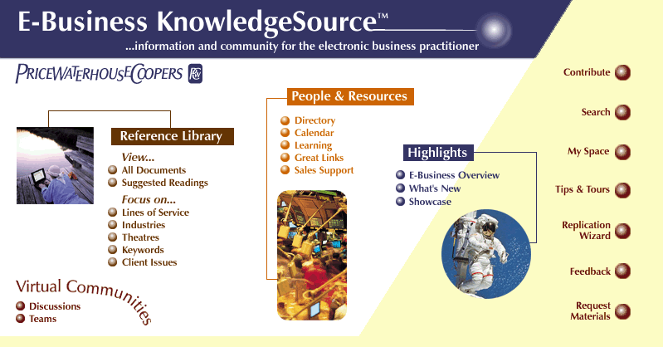


PricewaterhouseCoopers: An Extraordinary Resource
Largest professional services organization in the world
Second largest strategic consulting practice in the world
2000 dedicated e-business professionals worldwide
Specialized practice in Retail E-Business, focusing on strategy through implementation
Strong, committed project management
Deep industry experience
World-class partnerships with:
  CommerceNet
  Internet Advertising Bureau
  Shop.org
  Gartner Group
  Direct Marketing Association
  National Retail Association
In-House Resources:
E-Business Tech Forecast
E-Business KnowledgeSource proprietary database
Retail Intelligence System
World’s Largest Retail Research Library

Slide 36
Last year, Gartner Group identified PricewaterhouseCoopers as a leader in vision development and ability to execute top line management initiatives
Challengers
Leaders
Strategic change
IBM
PricewaterhouseCoopers
Data
warehousing
MCI system house
Deloitte & Touche
Ernst & Young
James Martin & Co
Relationship
marketing
Ability to execute
Andersen Consulting
Data
mining
KPMG Peat
Marwick
CSC Consulting
DMR
Sales force
productivity
Call
center
Agilis
Niche players
Visionaries
Completeness of vision

Slide 37
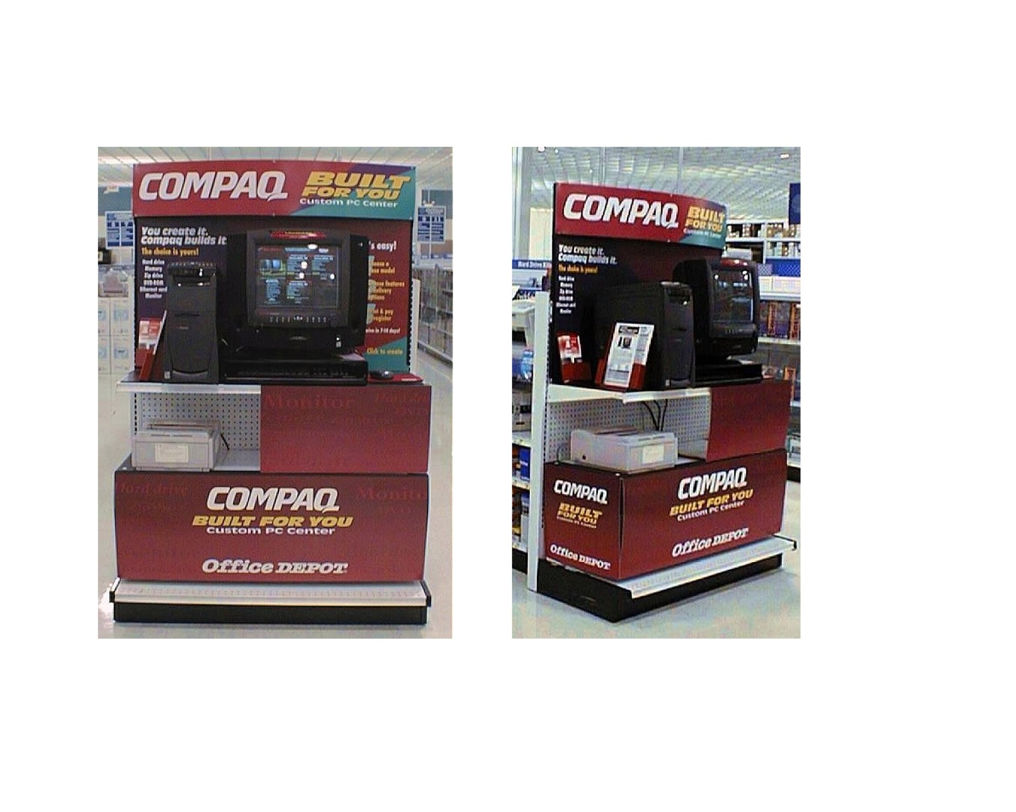
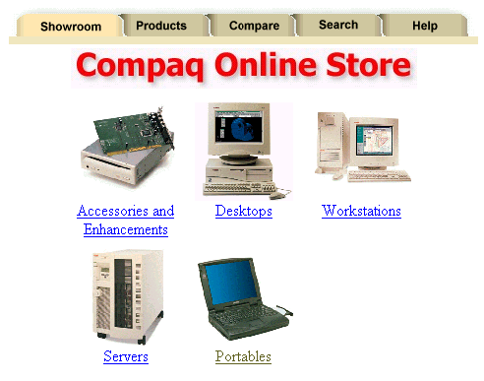

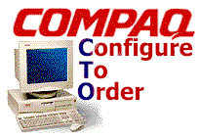

PwC worked with Compaq to design and build a global internet solution that launched its direct-to-consumer channel and also served existing channels through an integrated back-end solution
Implemented a leads-management and product-configuration application that is fully integrated with Siebel
Created an interface engine capable of integrating all of Compaq’s legacy systems with the Internet
Provided guidance for revised business processes and changed organizations
Established 42 distribution channels and 1,000 resellers in the US, UK, and France
Installed kiosks in 40 locations at three major retailers
Consumer
Website
on-line Store Applications
SAP
Planning
Suppliers
Order Management
Accounts
Configurator
Partners
Other Legacy Systems
Implemented custom sites for 5 major accounts, including 1 worth $300 million over five years
Call Center
Fulfillment
Customer
Constructed product configurator to enable Compaq to sell directly to end-customers via the Web

Slide 38

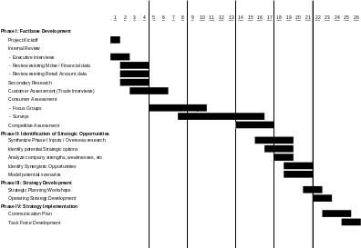
We recently worked with CVS to develop their B2C E-Commerce initiative, focusing on validating their strategy and planning the implementation efforts
Strategy
Validation
POSITIONING VARIABLES
EXECUTION VARIABLES
CORE
CUSTOMERS
FINANCIAL
PERFORMANCE
GOALS
SITE DESIGN,
LAYOUT, AND
FEATURES
Functional/ Information Requirements
CORE
MERCHANDISE
MERCHANDISING /
CONTENT
CORE
COMPETITION
BUSINESS
STRATEGY
PRICING /
PROMOTIONS
KEY APPEALS
CUSTOMER
SERVICE
MARKETING /
ADVERTISING /
PARTNERSHIPS
Implementation Strategies
FULFILLMENT /
DELIVERY
Implementation / Resource
Plan
PwC worked with CVS in an intensive two month effort to:
  Develop the strategy / business plan for CVS’ B2C E-Commerce initiative
  Develop business / functional requirements for the initial launch
  Evaluate potential implementation strategies
  Build the implementation and resource plan

Slide 39











PwC has relevant E-Business experience for a number of leading on-line and off-line companies

Slide 40
We additionally have a long history of working for leading retail and consumer goods companies
  Amerada Hess
  American Stores
  AMOCO
  Anheuser-Busch
  Ann Taylor
  Appletree Companies
  AT&T
  Bear Creek
  Bergdorf Goodman
  Bradlees
  Brinker/Eatzi’s
  Builders Square
  Caldor
  Calvin Klein
  Campbell Soup
  Chevron
  Coca-Cola
  Coors
  Cracker Barrel
  CVS Pharmacies
  Damark
  Discovery Channel
  Disney Stores
  Eddie Bauer
  Family Dollar Stores
  Federated Department Stores
  Giant Eagle
  Giant Food
  Gillette
  Goodwill
  Goody’s Family Clothing
  Hallmark
  Hannaford Bros.
  J.C. Penney
  Jumbo Sports
  Kmart
  Loehmann’s
  MCA/Universal
  MCI
  Montgomery Ward
  MTV
  Neiman Marcus
  Nestle USA Foods
  Nickelodeon
  OfficeMax
  Osh Kosh B’Gosh
  Pennsylvania House
  Pepsi-Cola
  PGA of America
  Procter & Gamble
  Ralph Lauren / Polo
  Saks Fifth Avenue
  Shell Oil Company
  Simon & Schuster
  Standard Brands
  Staples
  Stop and Shop
  The Bombay Company
  The GAP
  Time Warner
  Tommy Hilfiger
  Topco
  Toys “R” Us
  Warnaco
  Warner Bros. Stores
  Warner Lambert
  WAWA
  WM Wrigley

